Slide 1
CMSC 471:
Some AI Techniques in Machine Learning
Slides courtesy Frank Ferraro
1

Slide 2
Outline
Structured Prediction
Example Applications
Some Examples of Search
Some Examples of Logic
An Extension of Constraints: Integer Linear Programming
2

Slide 3
Classification
Classification: provide labels to an input item Labels are application/task dependent
Machine learning classification: Learn a function p_{α} to provide these labels automatically

Slide 4
Classification
Classification: provide labels to an input item Labels are application/task dependent
Machine learning classification: Learn a function p_{α} to provide these labels automatically
We assume there are some “weights” (parameters) that control the behavior of p_{α}.

Slide 5
Classification
Classification: provide labels to an input item Labels are application/task dependent
Machine learning classification: Learn a function p_{α} to provide these labels automatically
Input: Possible output labels:
Electronic alerts have been used to assist the authorities in moments of chaos and potential danger: after the Boston bombing in 2013, when the Boston suspects were still at large, and last month in Los Angeles, during an active shooter scare at the airport.
Tech
Not Tech

Slide 6







Classification vs. Structured Prediction
“Flat” prediction
y is a single label
Examples:
Document classification
Label a doc with its “topic”
Image classification
E.g., identify the (main) item in an image
Robot action prediction
Determine what action a robot should take
y =p_{α} ( )

Slide 7





Classification vs. Structured Prediction
“Flat” prediction
y is a single label
Examples:
Document classification
Label a doc with its “topic”
Image classification
y =p_{α} ( )
E.g., identify the (main) item in an image
Robot action prediction
Determine what action a robot should take
Structured prediction
y has some internal structure to predict
Examples:
Part of speech tagging
Identify each word in a sentence as a noun, verb, etc.
Action identification in video
(y₁, y₂,…,y_{M}) = p_{α} (
)

Slide 8
Example: Part-of-Speech Sequence Tagging
(i):
Adjective
Noun
Verb
Prep
Noun
Noun
p(British Left Waffles on Falkland Islands)

Slide 9
Example: Part-of-Speech Sequence Tagging
(i):
Adjective
Noun
Verb
Prep
Noun
Noun
(ii): Noun Verb Noun Prep Noun Noun
p(British Left Waffles on Falkland Islands)

Slide 10





Example: Handwriting Recognition
Data:
^{Sample 1:} u n e x. p e c t. e d
Sample 2: v o l c a n i c
Sample 2: e m b r a c e s
_{y}(1)
_{x}(1)
_{y}(2)
_{x}(2)
_{y}(3)
_{x}(3)
Figures from (Chatzis & Demiris, 2013)
10
Slide courtesy Matt Gormley

Slide 11
Example: Machine Translation/Word Alignment
Le chat est sur la chaise.
?
Le chat est sur la chaise.
The cat is on the chair.
The cat is on the chair.

Slide 12
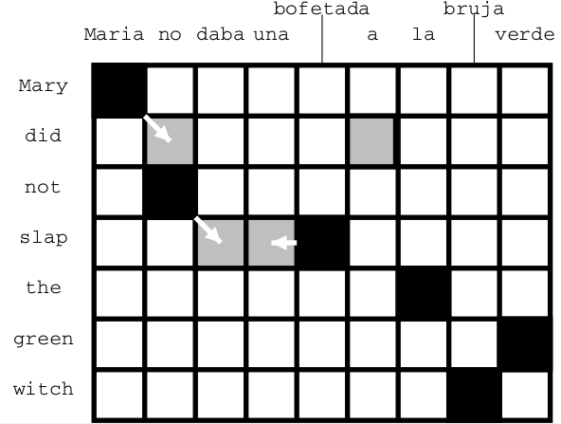
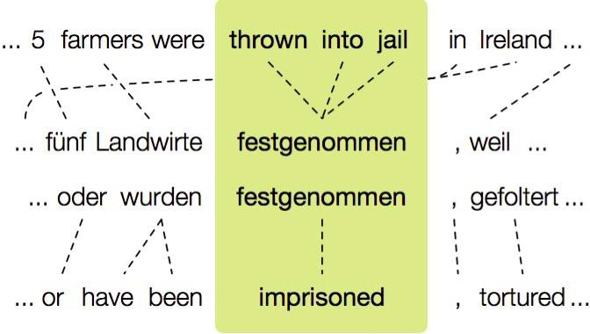
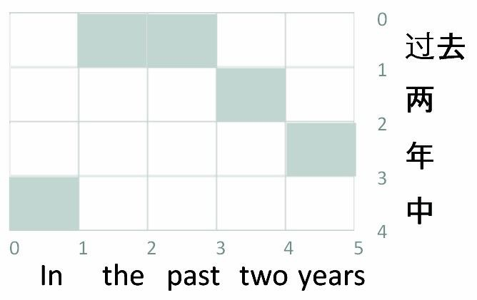
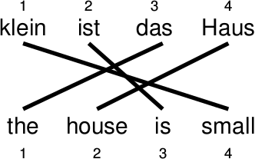
Example: Word Alignment, Phrase Extraction
http://www.cis.upenn.edu/~ccb/figures/research
-statement/pivoting.jpg

Slide 13


Example: Object Recognition
Data consists of images x and labels y.
leopard
Y
Slide courtesy Matt Gormley

Slide 14







Example: Object Recognition
Data consists of images x and labels y.
Preprocess data into
“patches”
leopard
Y
Slide courtesy Matt Gormley

Slide 15




Example: Object Recognition
Data consists of images x and labels y.
Preprocess data into
“patches”
Posit a latent labeling z describing the object’s parts (e.g. head, leg, tail, torso, grass)
Z₇
X₇
Z₂
X₂
leopard
Y
Slide courtesy Matt Gormley

Slide 16
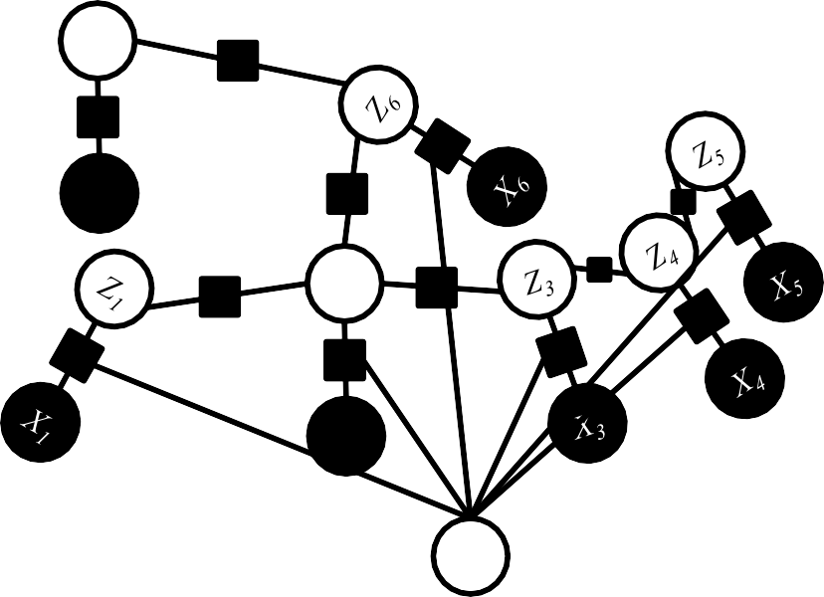
Example: Object Recognition
Data consists of images x and labels y.
Preprocess data into
“patches”
Posit a latent labeling z describing the object’s parts (e.g. head, leg, tail, torso, grass)
Define a “graphical model” with these latent variables in mind
Z₇
1
X₇
4
Z
2
4
X₂
z is not observed at train
or test time
leopard
Y
Slide courtesy Matt Gormley (edited)

Slide 17

Example: Sentence Parsing
S
NP
VP
Baltimore is a great city
Noun
Verb
NP
Baltimore
is
a great city
Sentence
Structured analysis (parse) of the sentence (diagramming a sentence)

Slide 18
Outline
Structured Prediction
Example Applications
Some Examples of Search
Some Examples of Logic
An Extension of Constraints: Integer Linear Programming
2

Slide 19
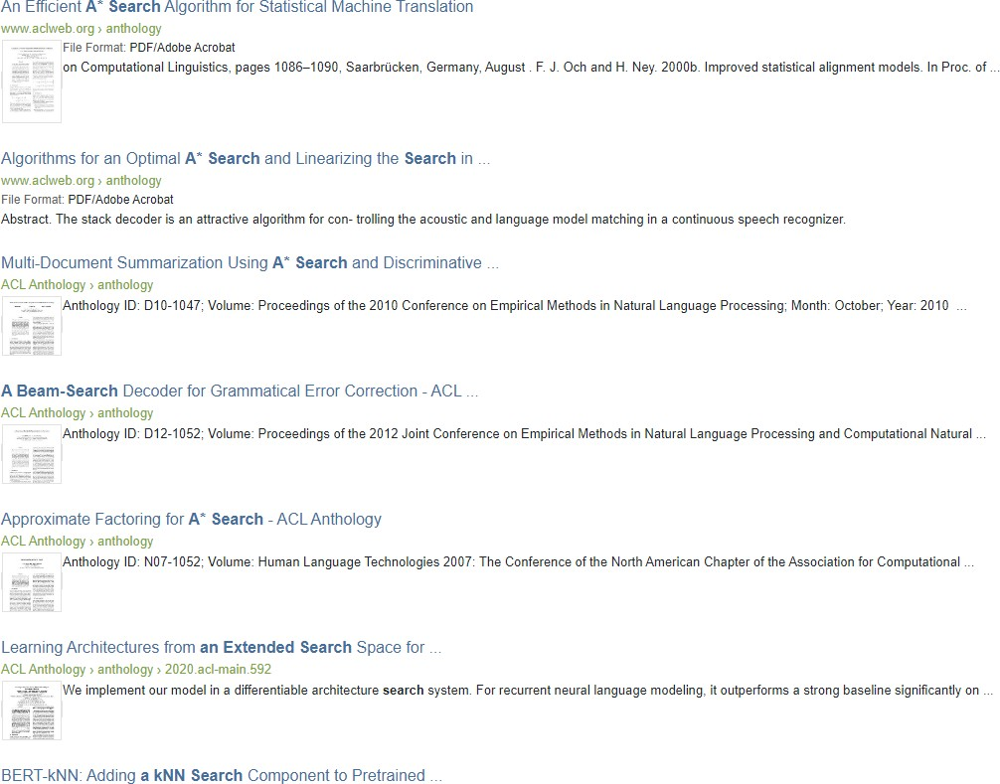
Search in NLP
19
https://www.aclweb.org/anthology/search/?q=a*+search

Slide 20
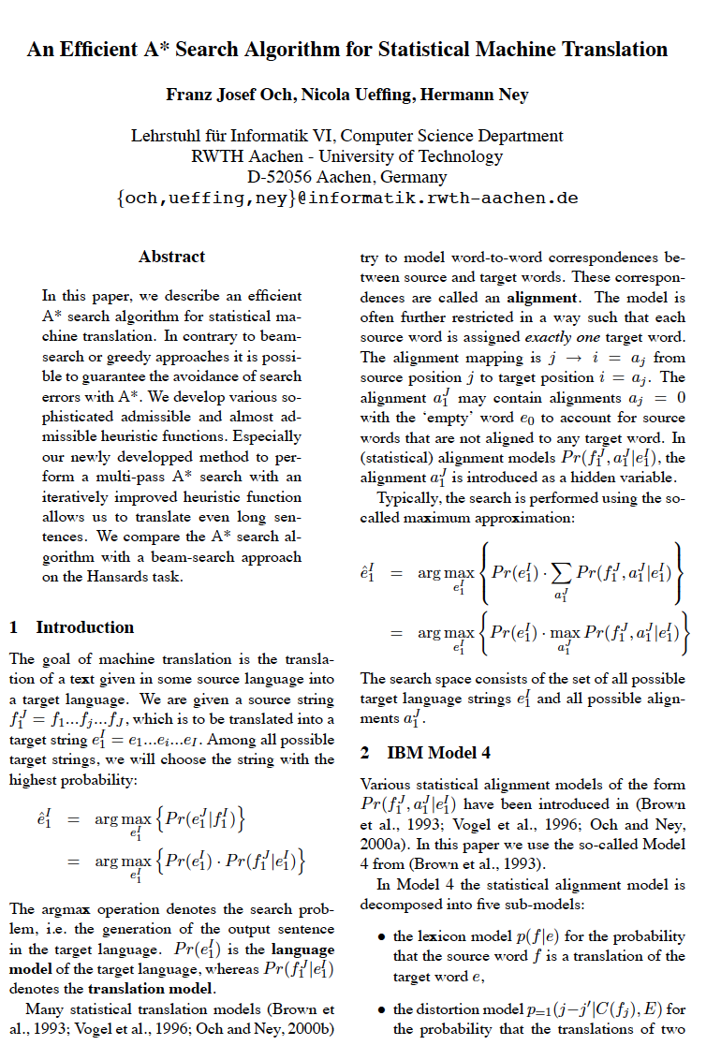
Core idea: searching for the correct
translation
State: the current partial translation
Actions: translating the next word

Slide 21
Core idea: searching for the correct
translation
State: the current partial translation
Actions: translating the next word
Cool part: an admissible heuristic!
“heuristic function including a coupling between translation, fertility, and language model probabilities [scores]“
How do they show it? By using knowledge about how their particular approach computes these scores.

Slide 22
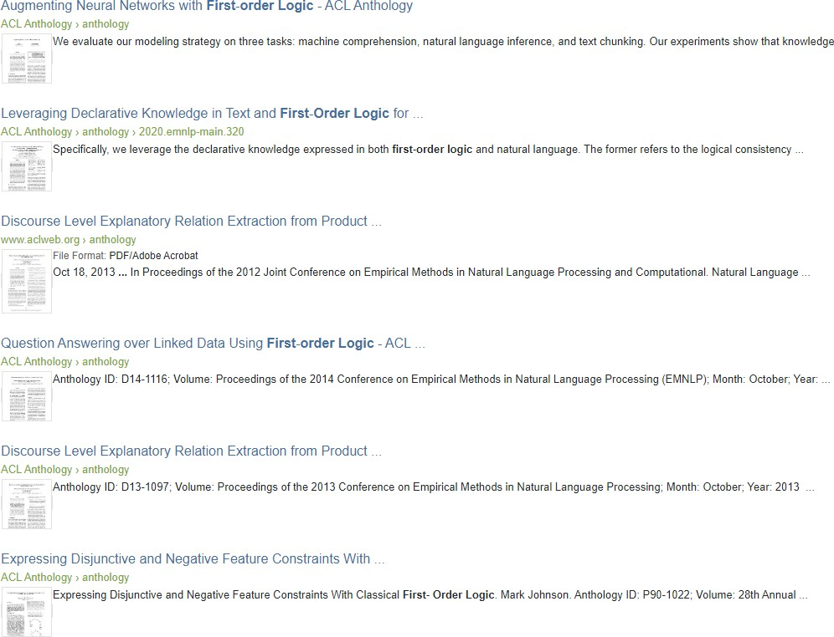
Logic in NLP
https://www.aclweb.org/anthology/search/?q=first+order+logic
23

Slide 23
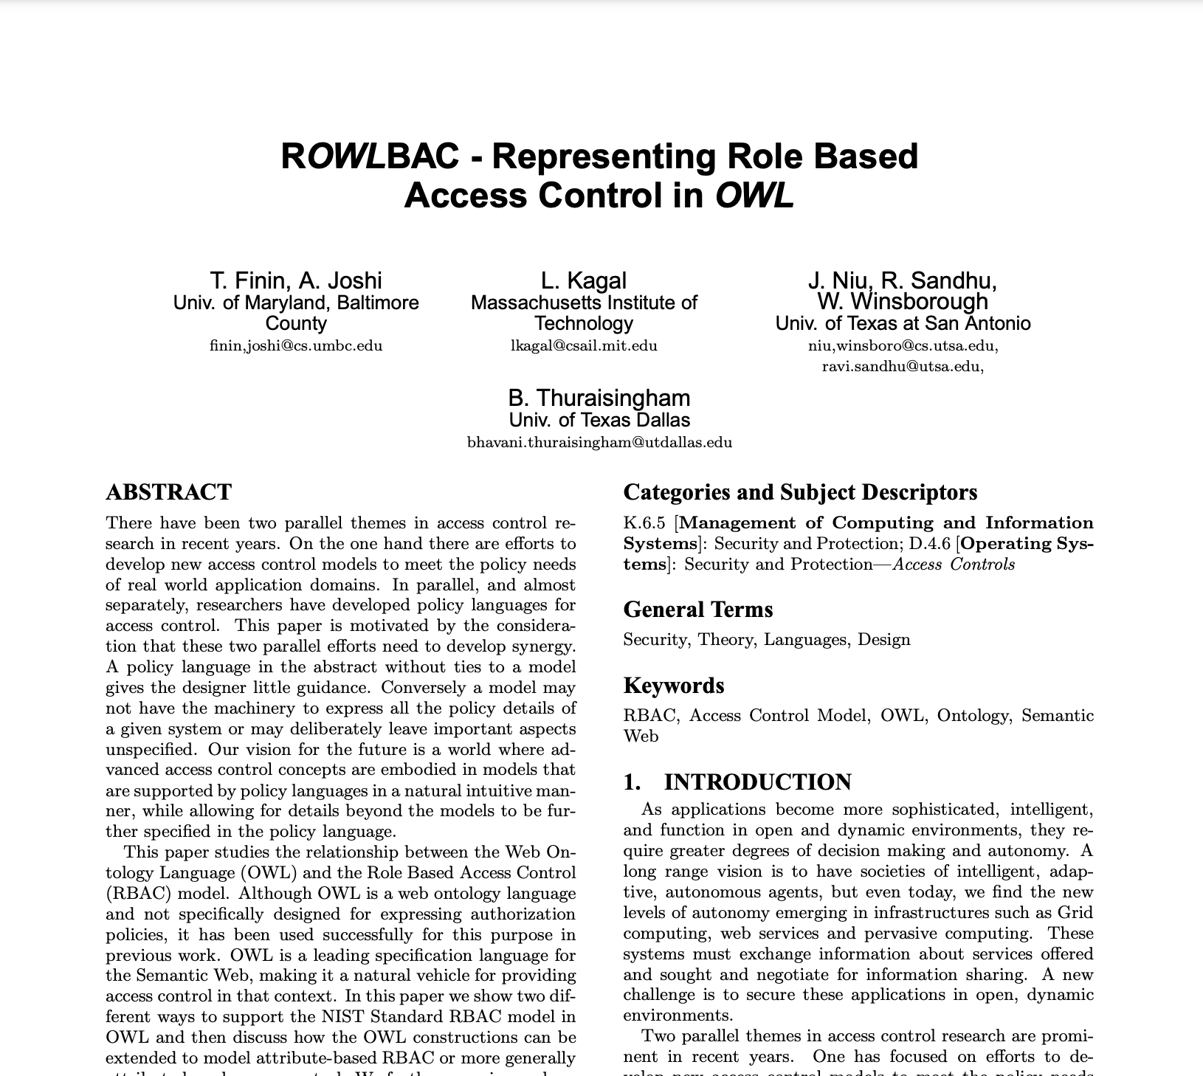

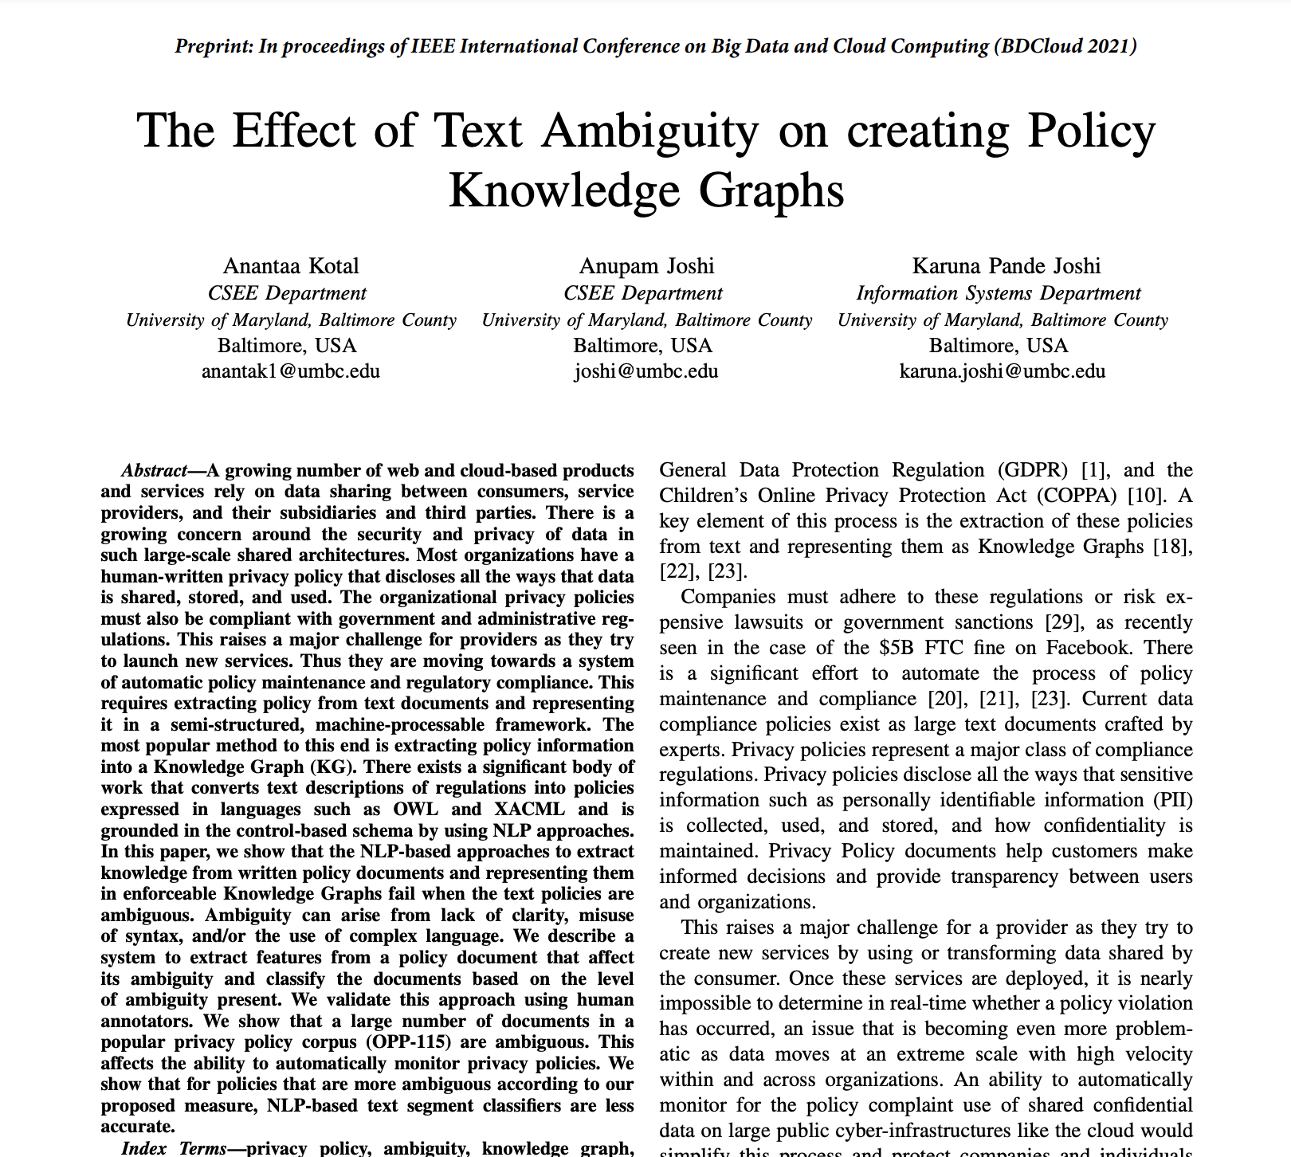
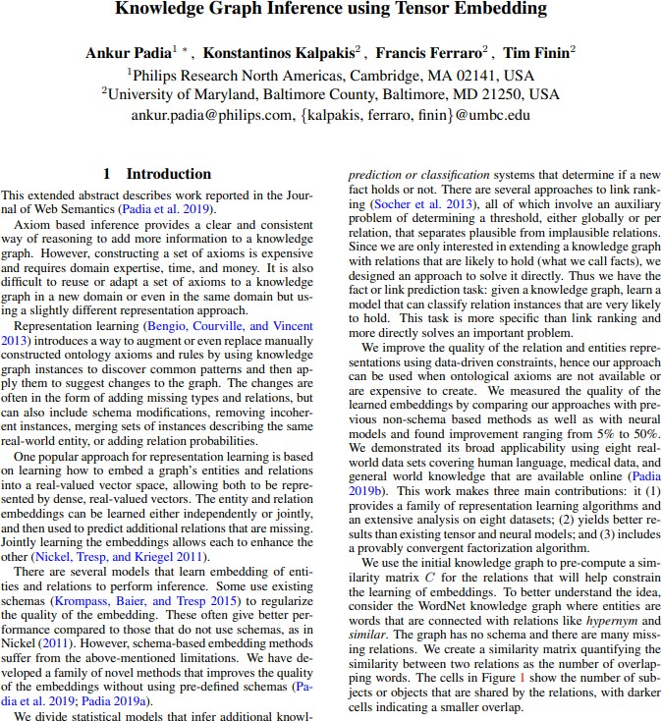
… and local chances to get involved
(these combine neural networks, propositional logic-based knowledge bases, structured prediction and security concepts)
24

Slide 24
Outline
Structured Prediction
Example Applications
Some Examples of Search
Some Examples of Logic
An Extension of Constraints: Integer Linear Programming
2

Slide 25
Linear Programming
𝐴𝑊 ≤ 𝐵
𝑎₁𝑤₁ + 𝑎₂𝑤₂ + ⋯ 𝑎_{𝑀}𝑤_{𝑀} ≤ 𝑏
input data
max 𝑊 𝑥 subject to
𝑊
linear constraints on W
matrix (or vector) of
learned parameters
26

Slide 26
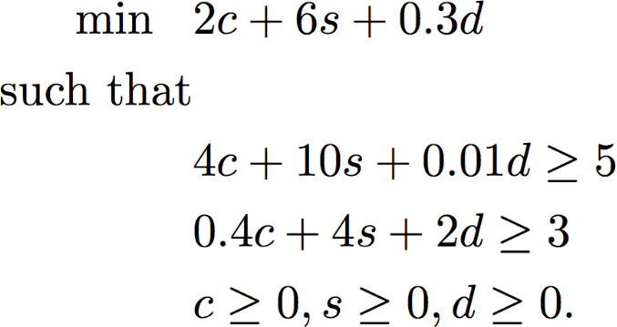
Example: The diet problem
A student wants to spend as little money on food while getting sufficient amount of vitamin Z and nutrient X. Her options are:
Item | Cost/100g | Vitamin Z | Nutrient X
Carrots | 2 | 4 | 0.4
Sunflower seeds | 6 | 10 | 4
Double cheeseburger | 0.3 | 0.01 | 2
How should she spend her money to get at least 5 units of vitamin Z and 3 units of nutrient X?
Let c, s and d denote how much of each item is purchased
Minimize total cost
At least 5 units of vitamin Z,
At least 3 units of nutrient X,
The number of units purchased is not negative
Roth & Srikumar: ILP formulations in Natural Language Processing

Slide 27
Example: The diet problem
A student wants to spend as little money on food while getting sufficient amount of vitamin Z and nutrient X. Her options are:
Item | Cost/100g | Vitamin Z | Nutrient X
Carrots | 2 | 4 | 0.4
Sunflower seeds | 6 | 10 | 4
Double cheeseburger | 0.3 | 0.01 | 2
How should she spend her money to get at least 5 units of vitamin Z and 3 units of nutrient X?
Let c, s and d denote how much of each item is purchased
Minimize total cost
At least 5 units of vitamin Z,
At least 3 units of nutrient X,
The number of units purchased is not negative
Roth & Srikumar: ILP formulations in Natural Language Processing

Slide 28
Example: The diet problem
A student wants to spend as little money on food while getting sufficient amount of vitamin Z and nutrient X. Her options are:
Item | Cost/100g | Vitamin Z | Nutrient X
Carrots | 2 | 4 | 0.4
Sunflower seeds | 6 | 10 | 4
Double cheeseburger | 0.3 | 0.01 | 2
How should she spend her money to get at least 5 units of vitamin Z and 3 units of nutrient X?
Let c, s and d denote how much of each item is purchased
Minimize total cost
At least 5 units of vitamin Z,
At least 3 units of nutrient X,
The number of units purchased is not negative
Roth & Srikumar: ILP formulations in Natural Language Processing

Slide 29
Example: The diet problem
A student wants to spend as little money on food while getting sufficient amount of vitamin Z and nutrient X. Her options are:
Item | Cost/100g | Vitamin Z | Nutrient X
Carrots | 2 | 4 | 0.4
Sunflower seeds | 6 | 10 | 4
Double cheeseburger | 0.3 | 0.01 | 2
How should she spend her money to get at least 5 units of vitamin Z and 3 units of nutrient X?
Let c, s and d denote how much of each item is purchased
Minimize total cost
At least 5 units of vitamin Z,
At least 3 units of nutrient X,
The number of units purchased is not negative
Roth & Srikumar: ILP formulations in Natural Language Processing

Slide 30
Example: The diet problem
A student wants to spend as little money on food while getting sufficient amount of vitamin Z and nutrient X. Her options are:
Item | Cost/100g | Vitamin Z | Nutrient X
Carrots | 2 | 4 | 0.4
Sunflower seeds | 6 | 10 | 4
Double cheeseburger | 0.3 | 0.01 | 2
How should she spend her money to get at least 5 units of vitamin Z and 3 units of nutrient X?
Let c, s and d denote how much of each item is purchased
Minimize total cost
At least 5 units of vitamin Z, At least 3 units of nutrient X, The number of units
purchased is not negative
Roth & Srikumar: ILP formulations in Natural Language Processing

Slide 31






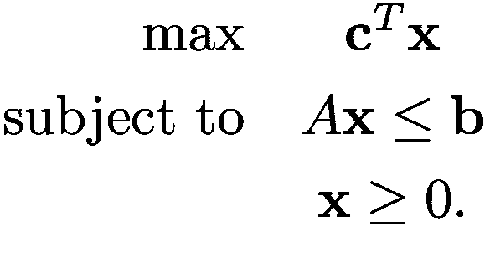


Geometric Views of the Constraints
The constraint matrix defines a polytope that contains allowed solutions (possibly not closed)
The objective defines cost for every point in the space
Even though all points in the region are allowed, points on the faces maximize/minimize the cost
Every constraint forbids a half-plane
The points that are allowed form the feasible region
32
Roth & Srikumar: ILP formulations in Natural Language Processing

Slide 32
Integer Linear Programming
Variables to assign
linear constraints on z
Each 𝑧_{𝑘} is an integer
max 𝑐^{𝑇}𝑧 subject to
𝑧
c: a matrix (or vector)
of learned parameters

Slide 33
Integer Linear Programming
𝐴𝑧 ≤ 𝐵
𝑎₁𝑧₁ + 𝑎₂𝑧₂ + ⋯ 𝑎_{𝑀}𝑧_{𝑀} ≤ 𝑏
Variables to assign
linear constraints on z
Each 𝑧_{𝑘} is an integer
max 𝑐^{𝑇}𝑧 subject to
𝑧
c: a matrix (or vector)
of learned parameters

Slide 34
Integer Linear Programming
𝐴𝑧 ≤ 𝐵
𝑎₁𝑧₁ + 𝑎₂𝑧₂ + ⋯ 𝑎_{𝑀}𝑧_{𝑀} ≤ 𝑏
Variables to assign
linear constraints on z
Each 𝑧_{𝑘} is an integer
max 𝑐^{𝑇}𝑧 subject to
𝑧
c: a matrix (or vector)
of learned parameters

Slide 35
Integer Linear Programming
𝐴𝑧 ≤ 𝐵
𝑎₁𝑧₁ + 𝑎₂𝑧₂ + ⋯ 𝑎_{𝑀}𝑧_{𝑀} ≤ 𝑏
Variables to assign
linear constraints on z
Each 𝑧_{𝑘} is an integer
max 𝑐^{𝑇}𝑧 subject to
𝑧
c: a matrix (or vector)
of learned parameters

Slide 36
Integer Linear Programming
𝐴𝑧 ≤ 𝐵
𝑎₁𝑧₁ + 𝑎₂𝑧₂ + ⋯ 𝑎_{𝑀}𝑧_{𝑀} ≤ 𝑏
Variables to assign
linear constraints on z
Each 𝑧_{𝑘} is an integer
max 𝑐^{𝑇}𝑧 subject to
𝑧
c: a matrix (or vector)
of learned parameters
ILP is NP-complete ☹

Slide 37
Integer Linear Programming
𝐴𝑧 ≤ 𝐵
𝑎₁𝑧₁ + 𝑎₂𝑧₂ + ⋯ 𝑎_{𝑀}𝑧_{𝑀} ≤ 𝑏
Variables to assign
linear constraints on z
Each 𝑧_{𝑘} is an integer
max 𝑐^{𝑇}𝑧 subject to
𝑧
c: a matrix (or vector)
of learned parameters
ILP is NP-complete ☹
But there are still well-designed
solvers ➔ it’s useful

Slide 38
Also Cool: Extend ILP to IQP Integer Quadratic Programming (with Linear constraints)
𝐴𝑊 ≤ 𝐵
𝑎₁𝑤₁ + 𝑎₂𝑤₂ + ⋯ 𝑎_{𝑀}𝑤_{𝑀} ≤ 𝑏
linear constraints on W
Each 𝑤_{𝑘} is an integer
max 𝑧𝑐^{𝑇}𝑧 subject to
𝑧
Quadratic term of our variables z
Depending on c, IQP can be easy or hard (NP-hard) ☹
But there are still well-designed
solvers ➔ it’s useful

Slide 39
So, how do we solve ILPs and IQPs?
Fundamentally, they’re a type of constraint (and search!) problem
“Branch and bound” is a very common
technique (Poole & Mackworth, Ch 3.8.1)
DFS, but keep the cost of the best solution found
Prune a path if its current cost + heuristic cost are worse than the cost of the best solution found
Think of this as path pruning (from search) + domain splitting (from CSPs)

Slide 40
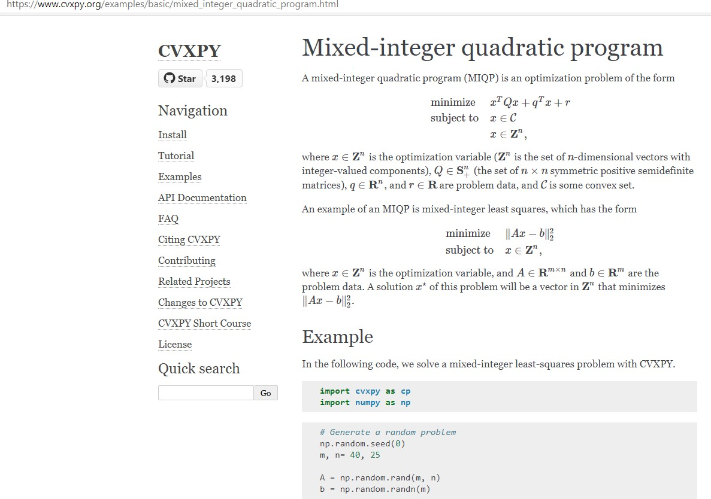
41

Slide 41
Example: Sequence Tag Prediction as an IQP
Adjective
Noun
Verb
Prep
British
Left
Waffles
on
…
Goal: Find the sequence of POS [part of speech] tags that maximize our score (given by
previously learned
weights)

Slide 42
Example: Sequence Tag Prediction as an IQP
Adjective
Noun
Verb
Prep
British
Left on
…
Waffles
Goal: Find the sequence of POS [part of speech] tags that maximize our score (given by
Put another way: We need to find an assignment of each word’s POS that maximize the score, subject to sequence constraints
previously learned
weights)

Slide 43
Example: Sequence Tag Prediction as an IQP
Put another way: We need to find an assignment of each word’s POS that maximize the score, subject to sequence constraints
British
Left Waffles on
Core ideas:
(1) Our quadratic score function 𝑓(𝑤, 𝑧) will depend on previously learned weights 𝑤 and the assignment to the structured 𝑧
…
44

Slide 44
Example: Sequence Tag Prediction as an IQP
Put another way: We need to find an assignment of each word’s POS that maximize the score, subject to sequence constraints
British Left
Core ideas:
(1) Our quadratic score function 𝑓(𝑤, 𝑧) will depend on previously learned weights 𝑤 and the assignment to the structured 𝑧
Waffles
on
…
(2) The assignment to 𝑧 must describe a valid sequence

Slide 45
Example: Sequence Tag Prediction as an IQP
linear constraints on z
Each 𝑧∗ is an integer
Prep
max 𝑓(𝑤, 𝑧) subject to
𝑧
Adjective
Noun
Verb
British
Left
Waffles
on
…

Slide 46
The Big Representational Choice
British Left Waffles
on
…
We are going to have a 𝑧 for each possible pair of time step (word) 𝑖 and POS tag 𝑘: 𝑧_{𝑖,𝑘}
Each 𝑧_{𝑖,𝑘} will be binary: 𝑧_{𝑖,𝑘} ∈ {0,1}
𝑧_{𝑖,𝑘} = 1 iff word 𝑖 has tag 𝑘

Slide 47
Example of our Representation
Adjective Noun Verb Prep
British
Left
Waffles
on
…
^{𝑧}1,Noun ⁼ ⁰
^{𝑧}1,Verb ⁼ ⁰
^{𝑧}1,Adj. ⁼ ¹
…
^{𝑧}2,Noun ⁼ ¹
^{𝑧}2,Verb ⁼ ⁰
^{𝑧}2,Adj. ⁼ ⁰
…
^{𝑧}3,Noun ⁼ ⁰
^{𝑧}3,Verb ⁼ ¹
^{𝑧}3,Adj. ⁼ ⁰
…
^{𝑧}4,Noun ⁼ ⁰
^{𝑧}4,Verb ⁼ ⁰
^{𝑧}4,Adj. ⁼ ⁰
…

Slide 48
Example of our Representation
Adjective Noun Verb Prep
British
Left
Waffles
on
…
Constraint 1: Each word must have at least one tag
^{𝑧}1,Noun ⁼ ⁰
^{𝑧}1,Verb ⁼ ⁰
^{𝑧}1,Adj. ⁼ ¹
…
^{𝑧}2,Noun ⁼ ¹
^{𝑧}2,Verb ⁼ ⁰
^{𝑧}2,Adj. ⁼ ⁰
…
^{𝑧}3,Noun ⁼ ⁰
^{𝑧}3,Verb ⁼ ¹
^{𝑧}3,Adj. ⁼ ⁰
…
^{𝑧}4,Noun ⁼ ⁰
^{𝑧}4,Verb ⁼ ⁰
^{𝑧}4,Adj. ⁼ ⁰
…
Constraint 2: Each word must have only one tag

Slide 49
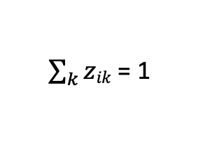
Example: Sequence Tag Prediction as an IQP
1. linear constraints on z
max 𝑓(𝑤, 𝑧) subject to
𝑧
2. Each 𝑧∗ is an {0, 1} integer
(One state per time)
$\sum_{k}{zik}$ = 1
for each time i

Slide 50
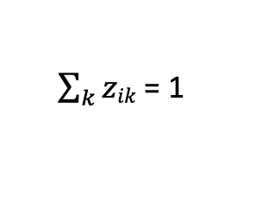
Example: Sequence Tag Prediction as an IQP
1. linear constraints on z
max 𝑓(𝑤, 𝑧) subject to
𝑧
2. Each 𝑧 is an {0, 1} integer
∗
$\sum_{k}{zik}$ = 1
for each time i

Slide 51
score(
)
Instance of data
(“datum”)

Slide 52
score ( )
scoring model
θ
Instance of data
(“datum”)
F(θ)
objective

Slide 53
score ( )
scoring model
θ
Instance of data (“datum”)
F(θ)
objective
(implicitly) dependent on the
observed data X=

Slide 54
Machine Learning Framework: Learning
instance 1
instance 2
Machine Learning Predictor
instance 3
instance 4

Slide 55
Machine Learning Framework: Learning
instance 1
instance 2
Machine Learning Predictor
instance 3
instance 4
instances are
typically examined independently
Inductive Bias

Slide 56
Machine Learning Framework: Learning
Gold/correct labels
instance 1
instance 2
Machine Learning Predictor
Evaluator
score
instance 3
instance 4
instances are
typically examined independently
Inductive Bias

Slide 57
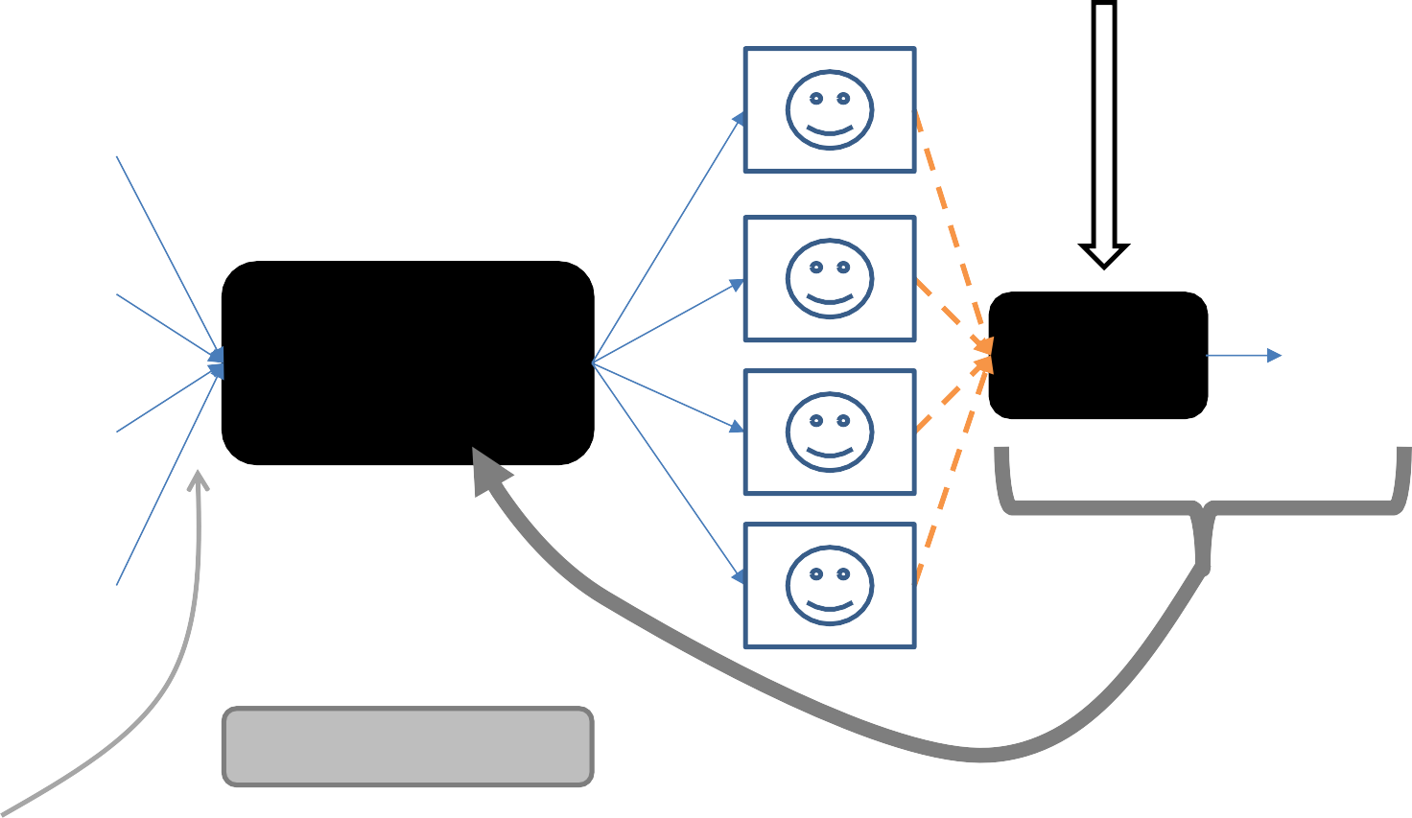
Gold/correct labels
instance 1
instance 2
Machine Learning Predictor
Evaluator
score
instance 3
instance 4
instances are typically examined independently
Inductive Bias
give feedback to the predictor

Slide 58


Classify with Goodness

